Slide 1

Walmart and Amazon Retail Industry Data Analysis

Slide 2
Agenda
Introduction
Visualization
Insights & recommendation
Summary

Slide 3

Introduction
The retail sector is known for its intense rivalry, thus success in this field depends on knowing the tactics used by the big competitors.
This proposal would concentrate on the retail sector and undertake a thorough examination of the price and product selection tactics used by Amazon and Walmart, the two major players in the market.
The dataset was supplied by Saturn Data and was taken from the AWS Marketplace (May 2023).

Slide 4
Problem Statement
What trends and patterns emerge in the pricing strategies of Walmart and Amazon?
In which departments and product categories do these companies concentrate their product offerings?
Is there a Correlation between the Walmart and Amazon current price?

Slide 5
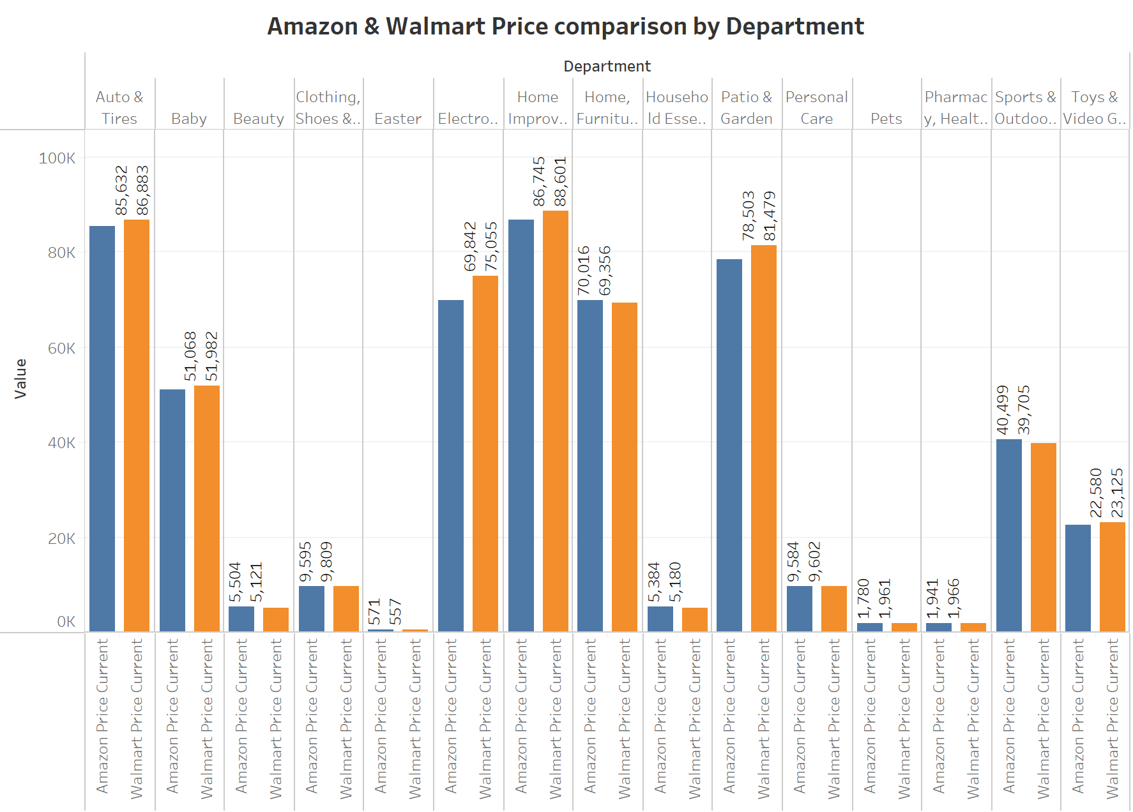
Visualization 1

Slide 6
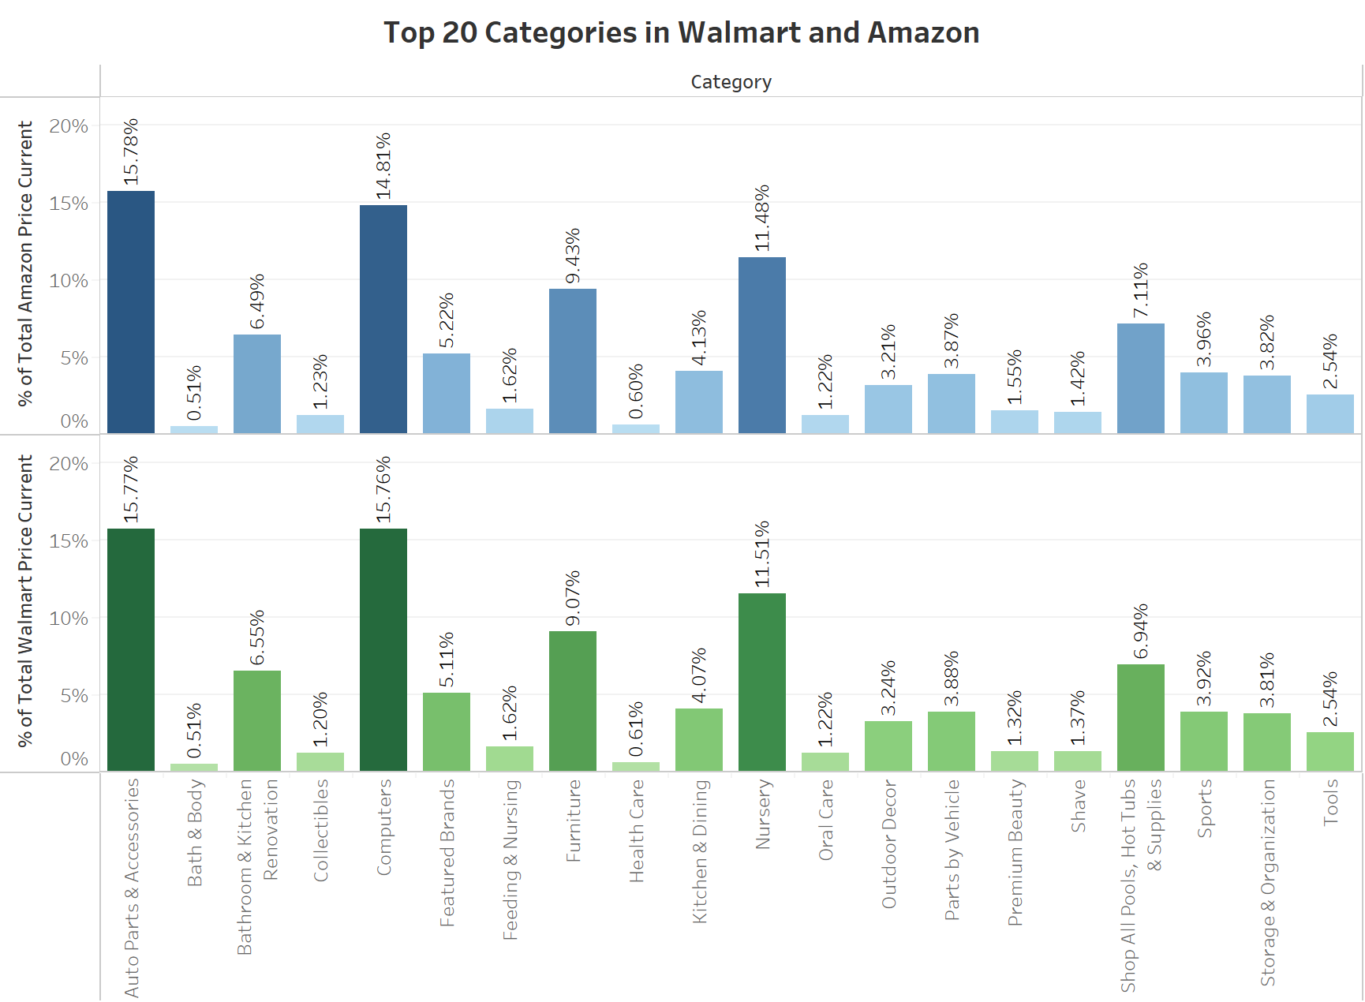
Visualization 2

Slide 7
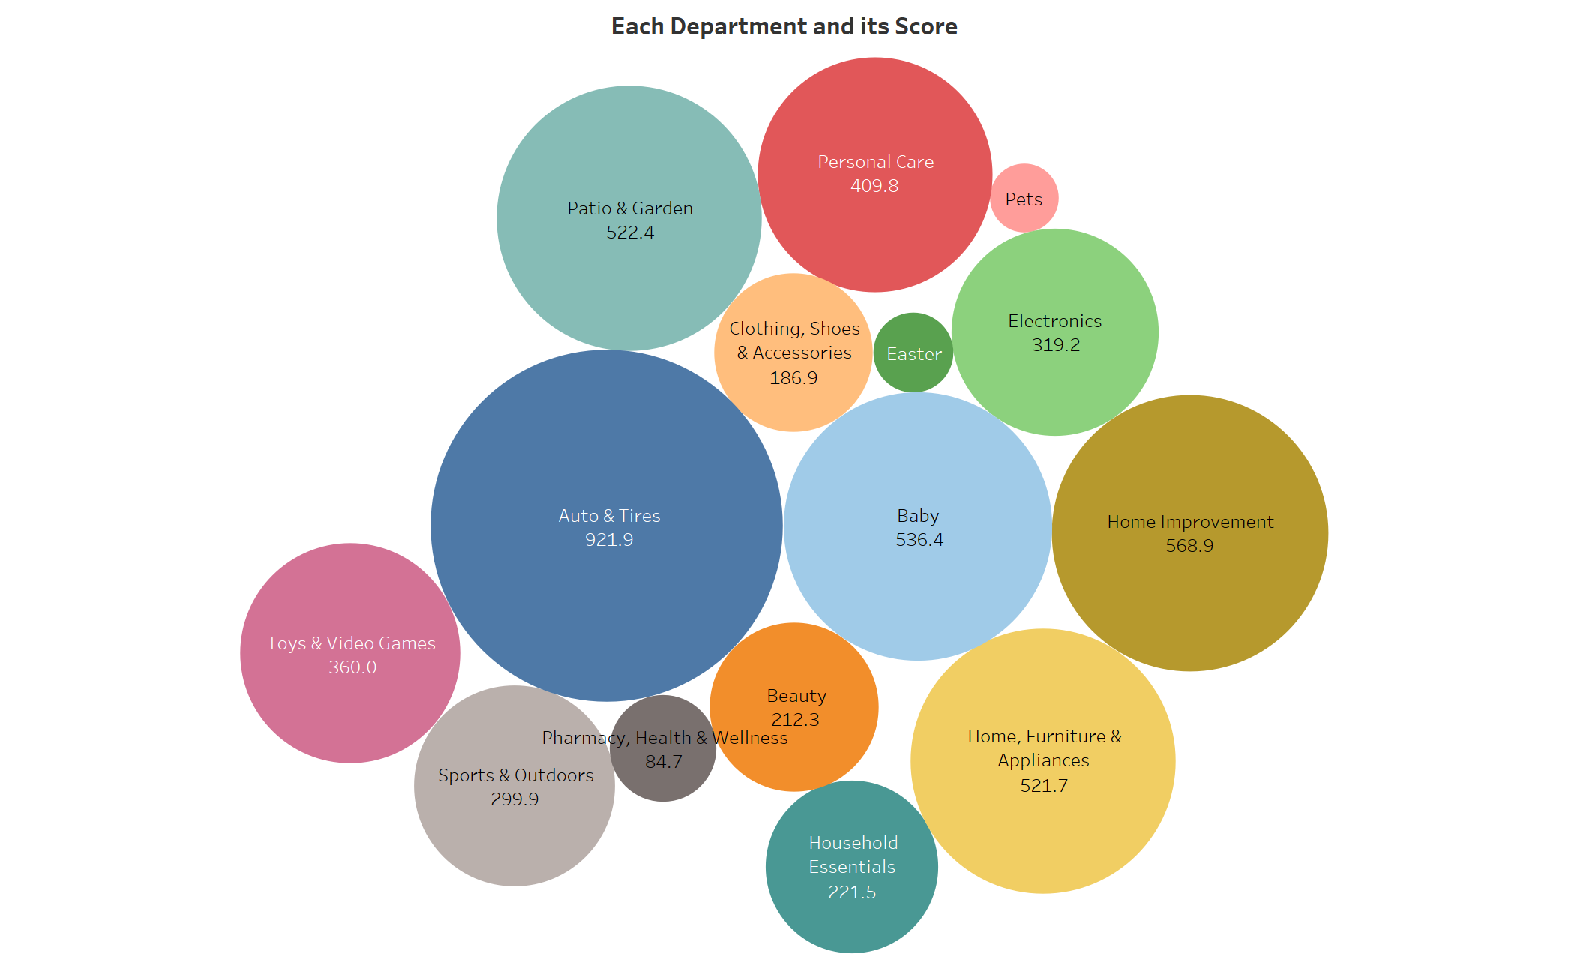
Visualization 3

Slide 8
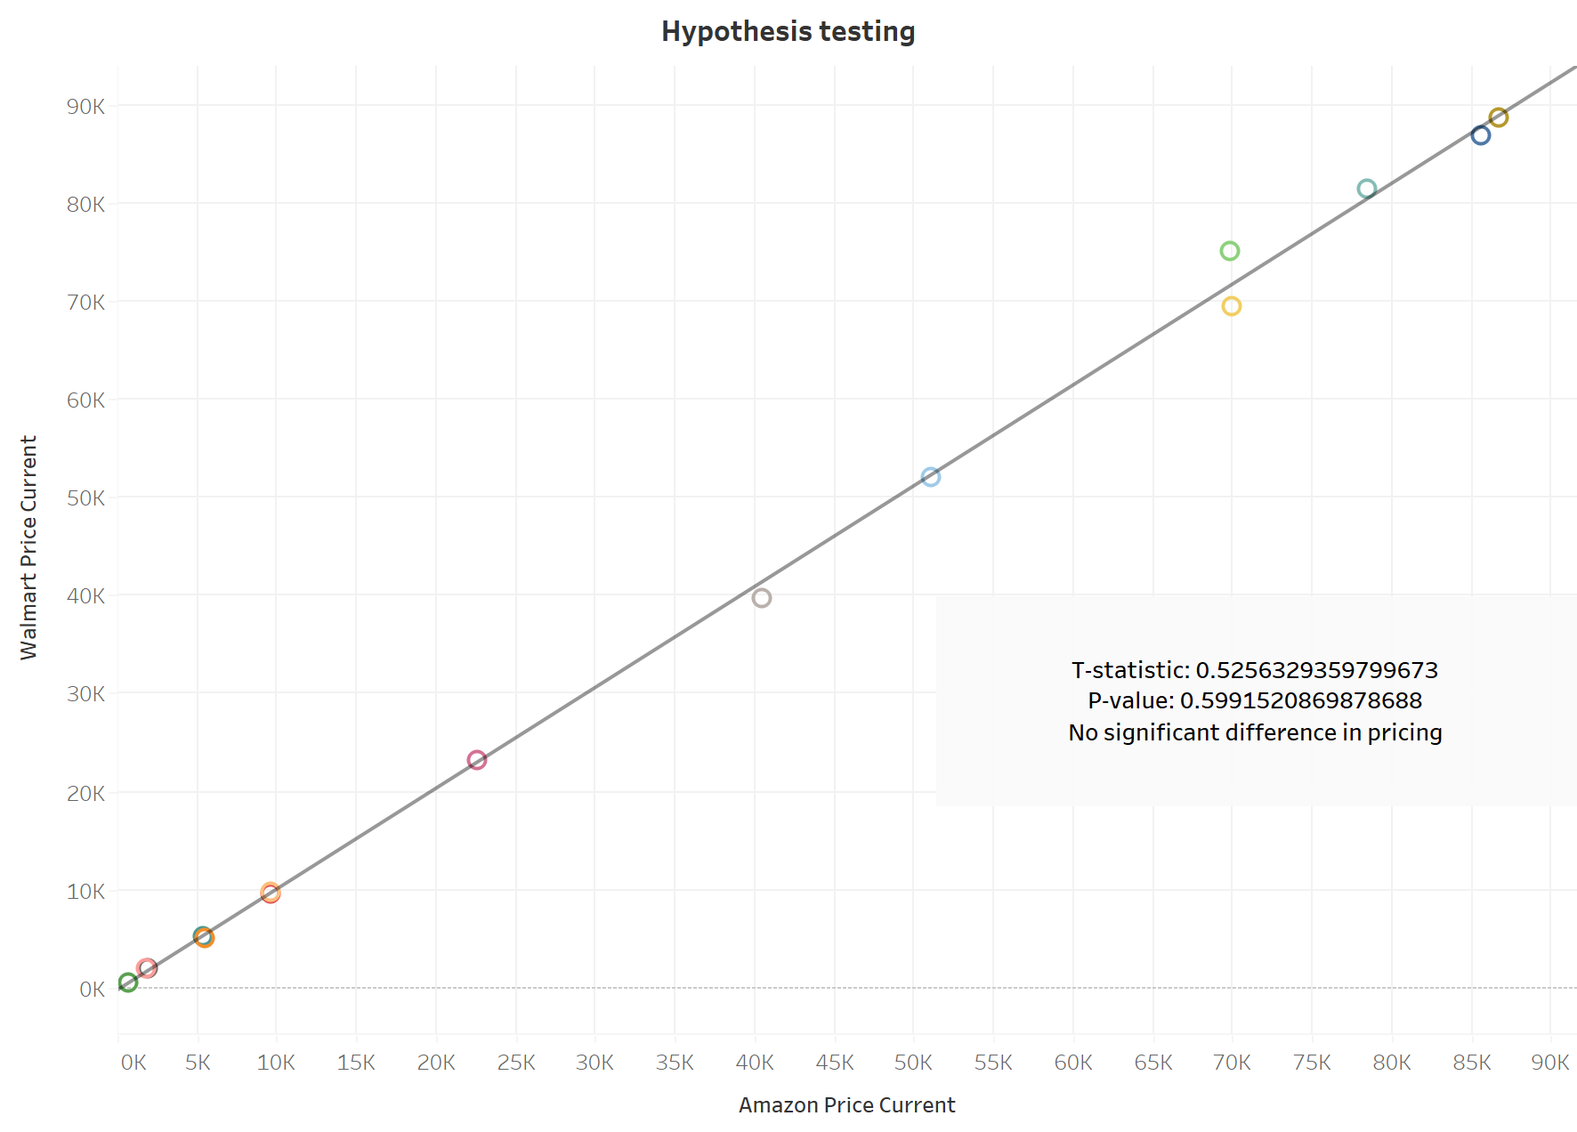
Hypothesis testing
The t-test results indicate that there is no significant difference in pricing between Walmart and Amazon.
The p-value of 0.599 is greater than the commonly chosen significance level of 0.05.
Therefore, we fail to reject the null hypothesis, suggesting that, based on the available data, there is insufficient evidence to conclude a meaningful difference in pricing strategies between the two retailers.

Slide 9
Insights & Recommendation
 | Insights | Recommendation
Home Improvements & Auto and tiers | Walmart's total current prices are slightly higher than Amazon in the Home Improvements(Walmart: 88601, Amazon: 86,745) & Auto and Tires category(Walmart: 86,883, Amazon: 85,632). Both retailers seem to be competitively pricing in this department. | Given Walmart's slightly higher total prices in these categories, the company may consider leveraging this advantage in marketing campaigns to attract customers looking for home improvement and auto-related products.
Easter & Toys | Walmart and Amazon have comparable total prices in the Easter category(Walmart: 557, Amazon: 571), indicating a competitive balance in pricing for seasonal items. Walmart has a slightly higher total sum of current prices in the Toys category(Walmart: 23125, Amazon: 22580), indicating a focus on providing diverse toy options. | With similar total prices in Easter and Toys, Walmart can maintain its competitive position by ensuring product availability and possibly introducing targeted promotions during peak seasons
Bath and Body, Health Care, Oral Care, Tools | Both Walmart and Amazon maintain a same percentage of total pricing for Bath & body, feeding, oral care & tools, showcasing a high level of consistency between the two retailers. | Leverage the consistent percentages in health-related categories (Bath and Body, Health Care, Oral Care) to streamline pricing strategies and potentially explore cross-promotional opportunities
Beauty | The Beauty category on Amazon has a higher percentage compared to Walmart, indicating potential pricing variations or strategies in this segment (Walmart: 1.32%, Amazon: 1.55%). A similar trend is observed in the Shave category. | Recognize and respond to category-specific dynamics. For instance, in the Beauty category where Amazon has a higher percentage, assess if there are opportunities for strategic pricing adjustments or promotional offers.
Baby, Auto & Tire, and Furniture | These departments have notably high total scores, indicating a positive reception among customers. The high scores may reflect customer satisfaction, diverse product offerings, or effective marketing strategies in these categories | Expanding product offerings, promoting customer reviews, and leveraging successful marketing strategies to maintain and potentially increase customer satisfaction
Easter, Pets, and Pharmacy | These departments have lower total scores. Investigate the reasons behind lower customer satisfaction, whether it be product availability, pricing, or other factors | Implement targeted improvements, such as optimizing product availability, pricing strategies, or introducing new initiatives to address customer concerns

Slide 10

Summary
In the retail data analysis of Walmart and Amazon, both giants exhibit competitive pricing strategies and diverse product assortments across departments and Category. Walmart's strength lies in high-scoring categories like Baby and Auto & Tire, while Amazon demonstrates competitiveness in various departments, including Electronics and Beauty. Recommendations focus on building on successes, enhancing customer experiences, and addressing specific areas for improvement. Continuous monitoring and adaptation are key for both retailers to navigate the dynamic retail landscape and maintain a strong competitive edge.

Slide 11

Thank you

